Slide 1
COMMODITIES MANAGEMENT

Slide 2
Presentation Layout
Problem Statement
Proposed Solution
HCMP Architecture
HCMP Walk Through
HCMP Set up
Notes:
Contact Person at health facility – ideal situation: Store Manager; Real situation: Facility Head / Dpt. Head / Nurse
Physical Stock Count – transcription errors
Quantification – under-quantification or over-quantification thus not being served with the required stock based on consumption. Time taken in quantifying for all the commodities that need to be ordered
Place Order – Time taken in waiting for the DP to collect order and rationalize before physically sending to KEMSA. Could take up to a week.
Carry out stock count on receipt of supply – Time taken to do stock count and when updating stock count there could be cases of transcription errors.
No way to monitor nearing expiring products as well as no means of immediate escalation of expired products

Slide 3
ESSENTIAL MEDICINES PROCESS FLOW - current
HEALTH FACILITY
DISTRICT PHARMACIST
KEMSA
* Physical stock count on bin cards
Physically collect order form from facility
Manually rationalize order
Physically send facility order sheets to KEMSA
Generate manual divisional reports
Issue to service points
Receive physical order forms
Feed order into ERP
Supply commodities
* Physical quantification of commodities to order
Place physical order to KEMSA *
Receive supply
Carry out a stock count
Physically update new stock count on bin cards
Notes:
Contact Person at health facility – ideal situation: Store Manager; Real situation: Facility Head / Dpt. Head / Nurse
Physical Stock Count – transcription errors
Quantification – under-quantification or over-quantification thus not being served with the required stock based on consumption. Time taken in quantifying for all the commodities that need to be ordered
Place Order – Time taken in waiting for the DP to collect order and rationalize before physically sending to KEMSA. Could take up to a week.
Carry out stock count on receipt of supply – Time taken to do stock count and when updating stock count there could be cases of transcription errors.
No way to monitor nearing expiring products as well as no means of immediate escalation of expired products

Slide 4
Health Commodities Management Platform (HCMP)
HEALTH FACILITY
DISTRICT PHARMACIST
KEMSA
Reconcile stock count online
Receive email notification of ;
  Orders placed
  Expired commodities
  Orders lead time
Approve order online, PDF is generated & emailed to KEMSA
Access online reports to monitor consumption trends.
Compare cost of expiries against cost of orders placed
Issue to service points
Decommission expired commodities
Receive order
Feed order into ERP
Supply commodities
Auto-quantification of commodities & placement of order online
Update supply delivery online
Generate facility reports
Notes:
System capabilities – Online, real-time and 24-hr accessibility
Health Facility user – Ideal situation: Store Manager; Real Situation: as prev. slide
Reconcile stock count – based on consumption and receipt, the system would extrapolate the current stock count and user would just need to take a few minutes to counter-check the values
Decommission expired commodities – email & sms notification to DP. Immediate escalation & action
Auto-quantification – formulation of exact quantities when ordering based on consumption and a buffer stock. No time required to carry this out. Order what you need philosophy. Minimizes over supply / under supplies
Email order – Immediate action
Update supply online – mitigate transcription errors

Slide 5
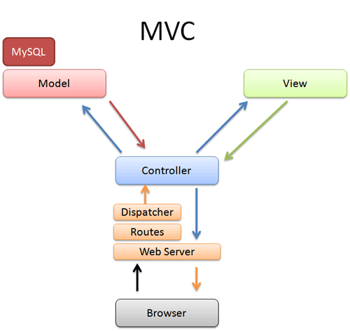
Health Commodities Management Platform (HCMP)

Slide 6
Health Commodities Management Platform (HCMP)
The Model represents your data structures. Typically your model classes will contain functions that help you retrieve, insert, and update information in your database.
The View is the information that is being presented to a user. A View will normally be a web page, but in CodeIgniter, a view can also be a page fragment like a header or footer. It can also be an RSS page, or any other type of "page".
The Controller serves as an intermediary between the Model, the View, and any other resources needed to process the HTTP request and generate a web page.

Slide 7
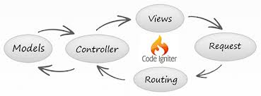
Health Commodities Management Platform (HCMP)
CodeIgniter is based on the Model-View-Controller development pattern. MVC is a software approach that separates application logic from presentation. In practice, it permits your web pages to contain minimal scripting since the presentation is separate from the PHP scripting.

Slide 8
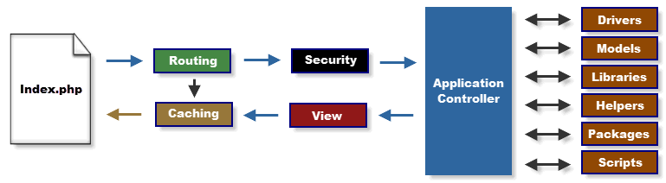
Health Commodities Management Platform (HCMP)

Slide 9
Health Commodities Management Platform (HCMP)
The index.php serves as the front controller, initializing the base resources needed to run CodeIgniter.
The Router examines the HTTP request to determine what should be done with it.
If a cache file exists, it is sent directly to the browser, bypassing the normal system execution.
Security. Before the application controller is loaded, the HTTP request and any user submitted data is filtered for security.
The Controller loads the model, core libraries, helpers, and any other resources needed to process the specific request.
The finalized View is rendered then sent to the web browser to be seen. If caching is enabled, the view is cached first so that on subsequent requests it can be served.

Slide 10
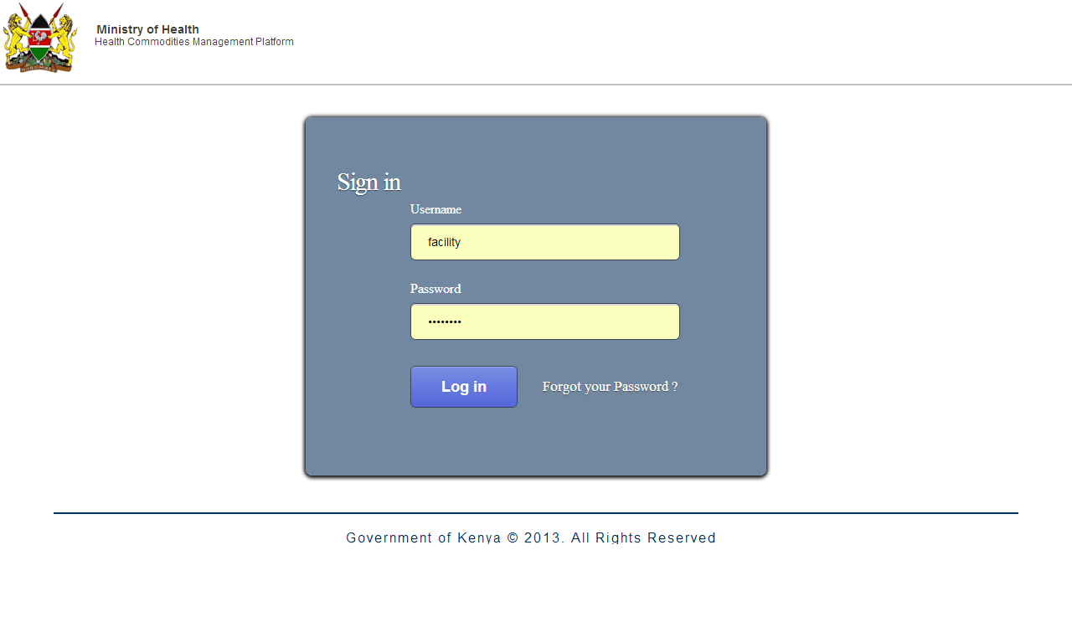
LEVEL 1: HEALTH FACILITY

Slide 11
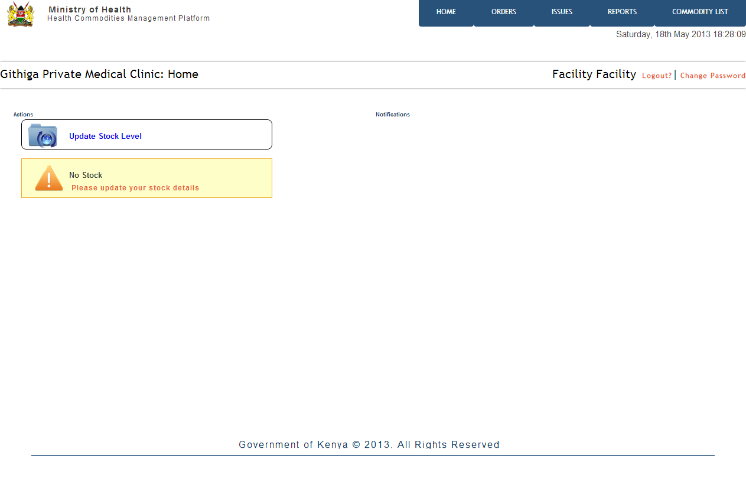
HOME SCREEN – New Facility

Slide 12
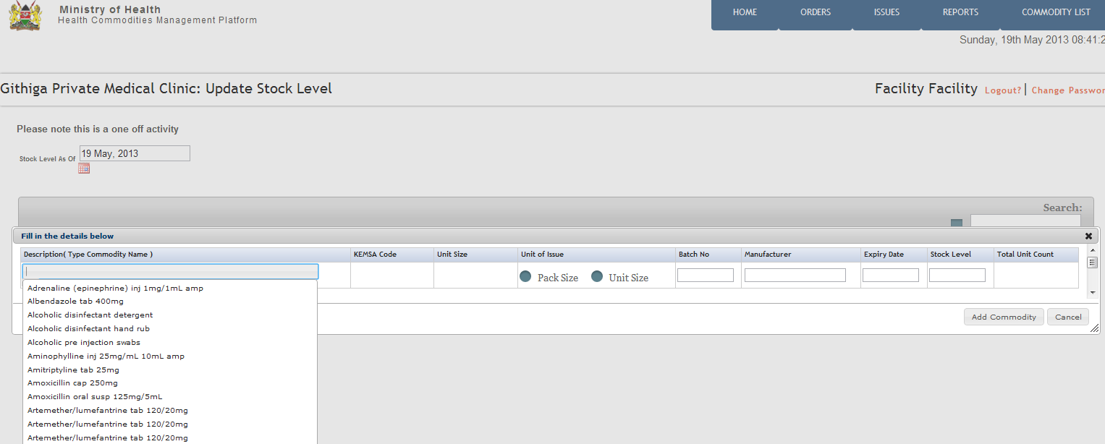
Update Stock Count Online

Slide 13
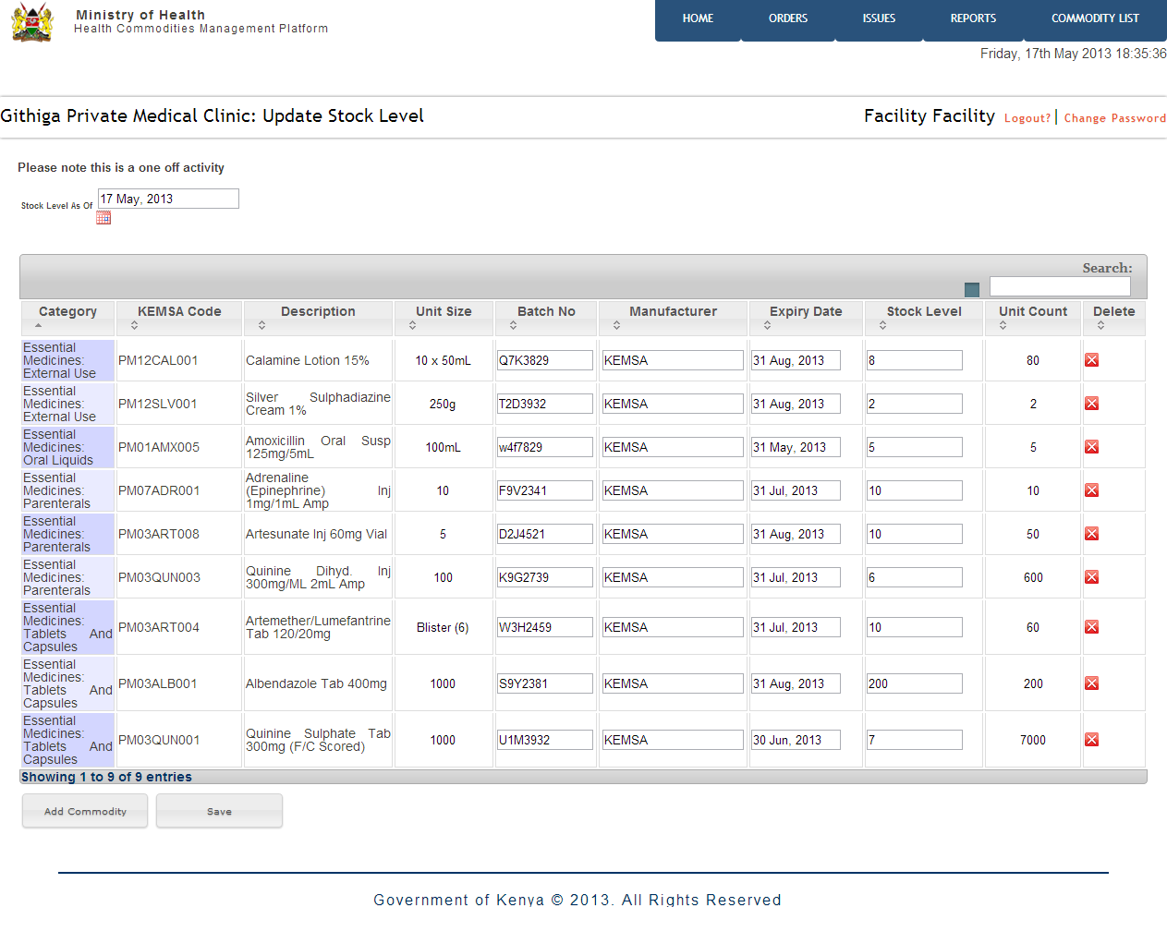
Update Stock Count Online

Slide 14
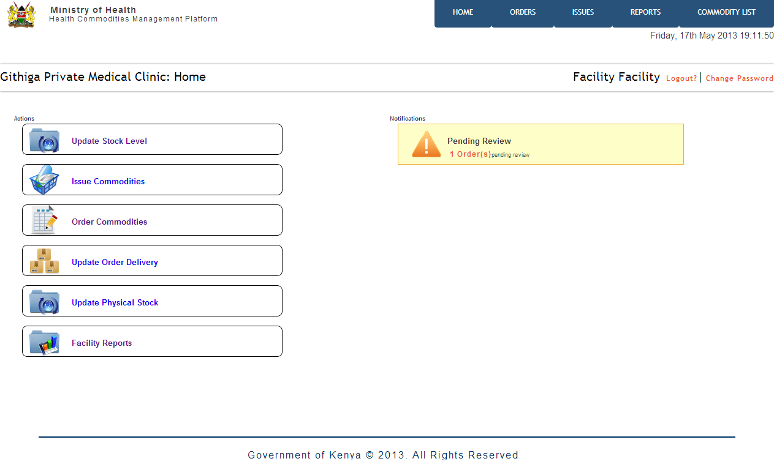
Home Screen

Slide 15
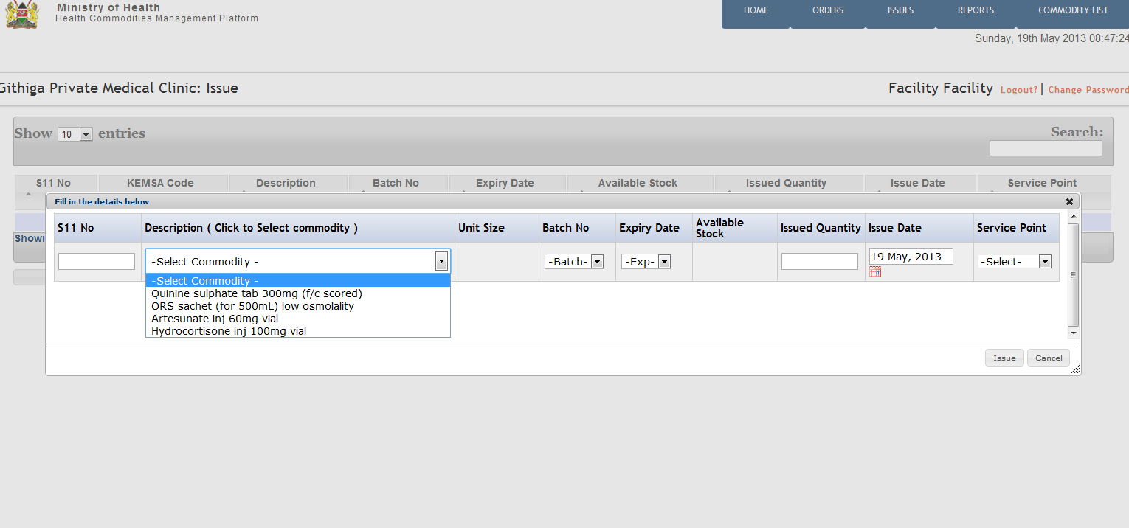
Issue Commodities to Service Points

Slide 16
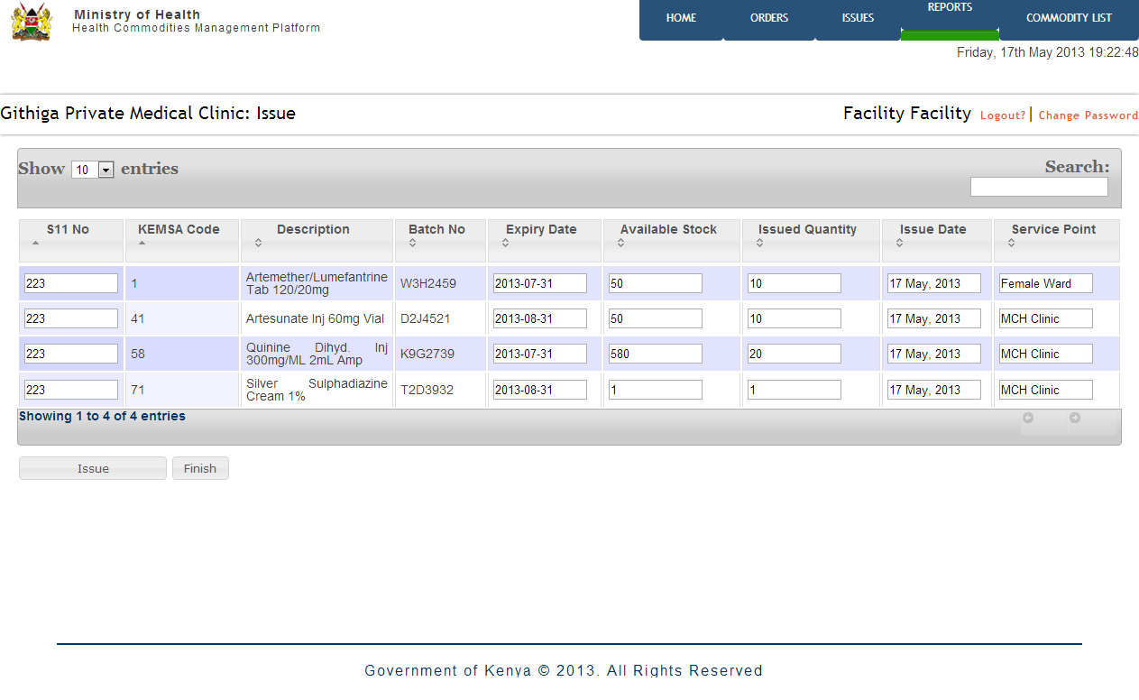
Issue Commodities to Service Points

Slide 17
Home Screen

Slide 18
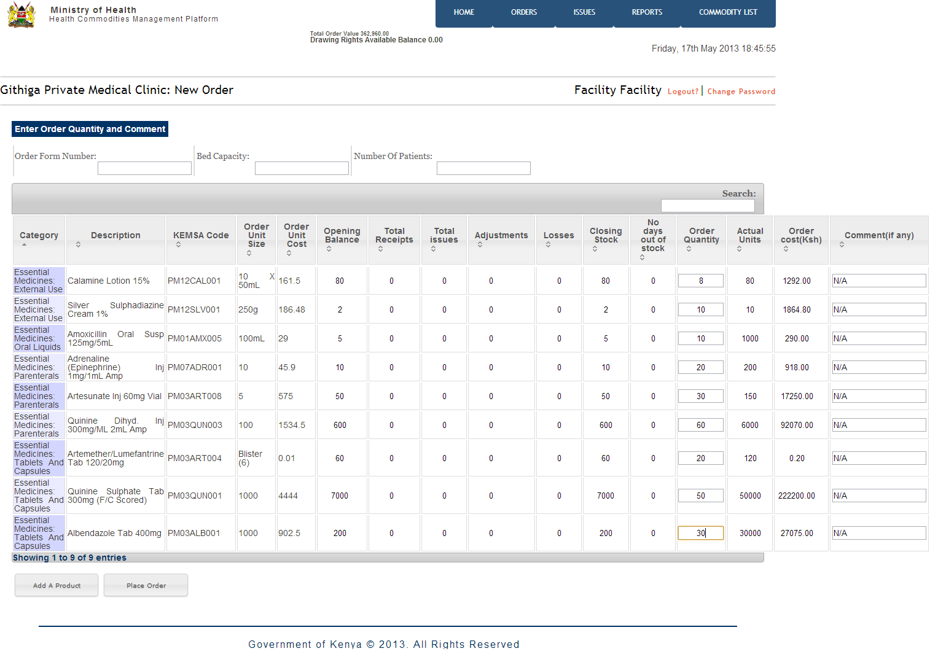
Place Order – Quantification of commodities

Slide 19
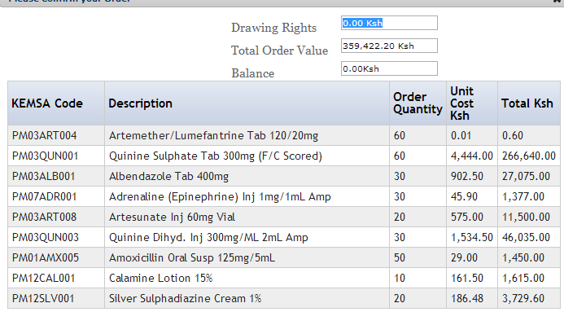
Place Order – Confirmation of Order

Slide 20
Home Screen

Slide 21
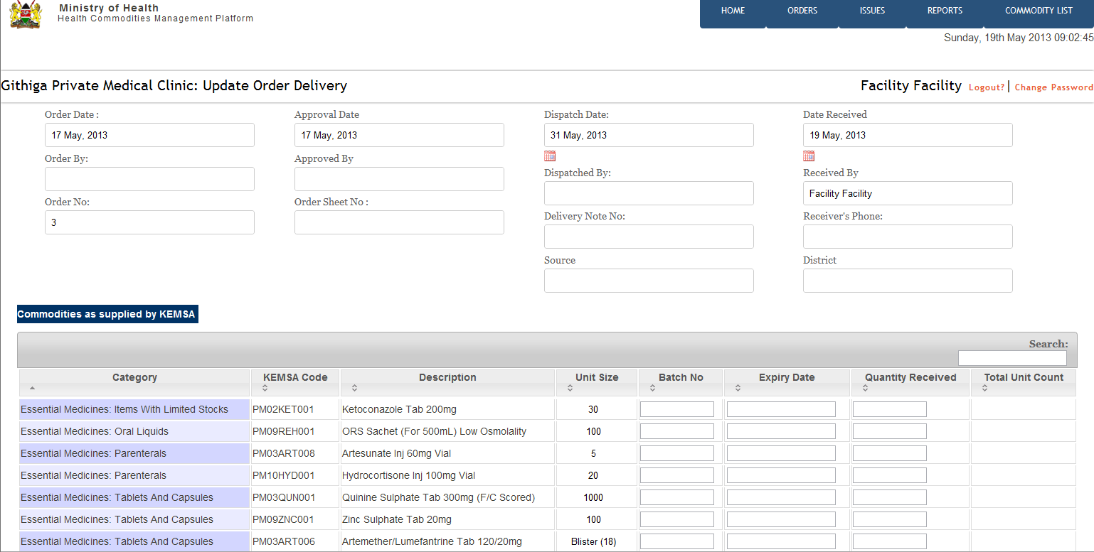
Update Order Delivery

Slide 22
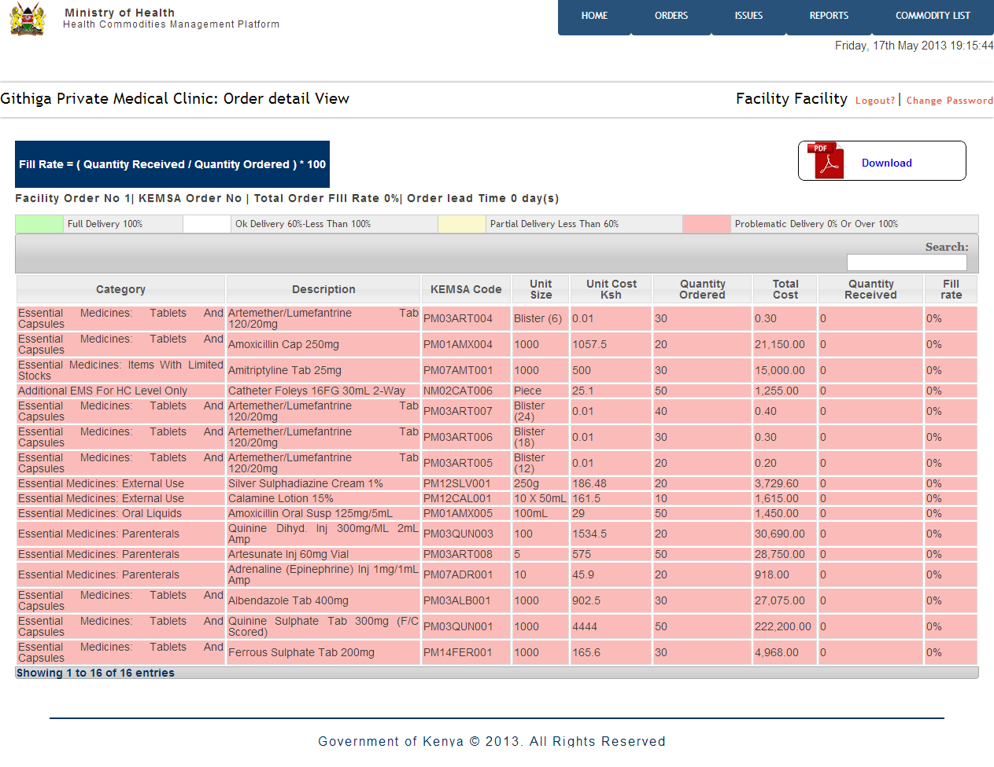
Update Order Delivery – Monitor Order Fill Rate

Slide 23
Home Screen

Slide 24
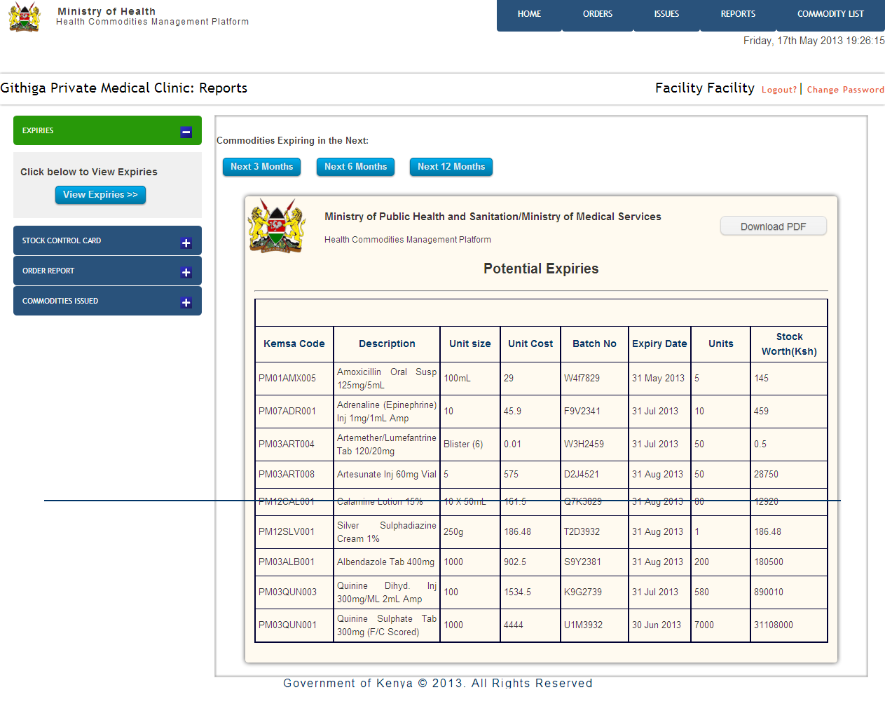
Facility Reports – Potential Expiries

Slide 25
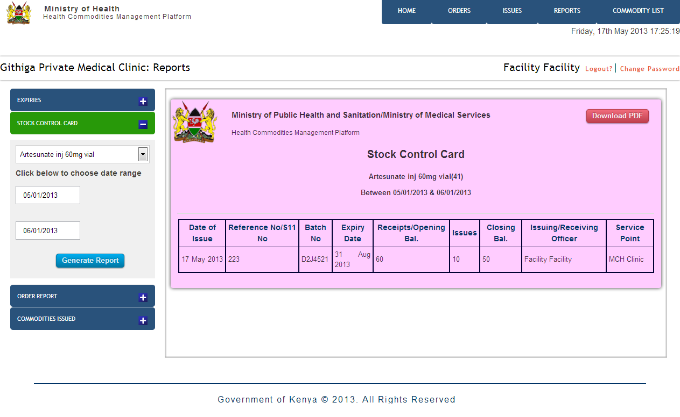
Facility Reports – Stock Control Card (Bin Card)

Slide 26
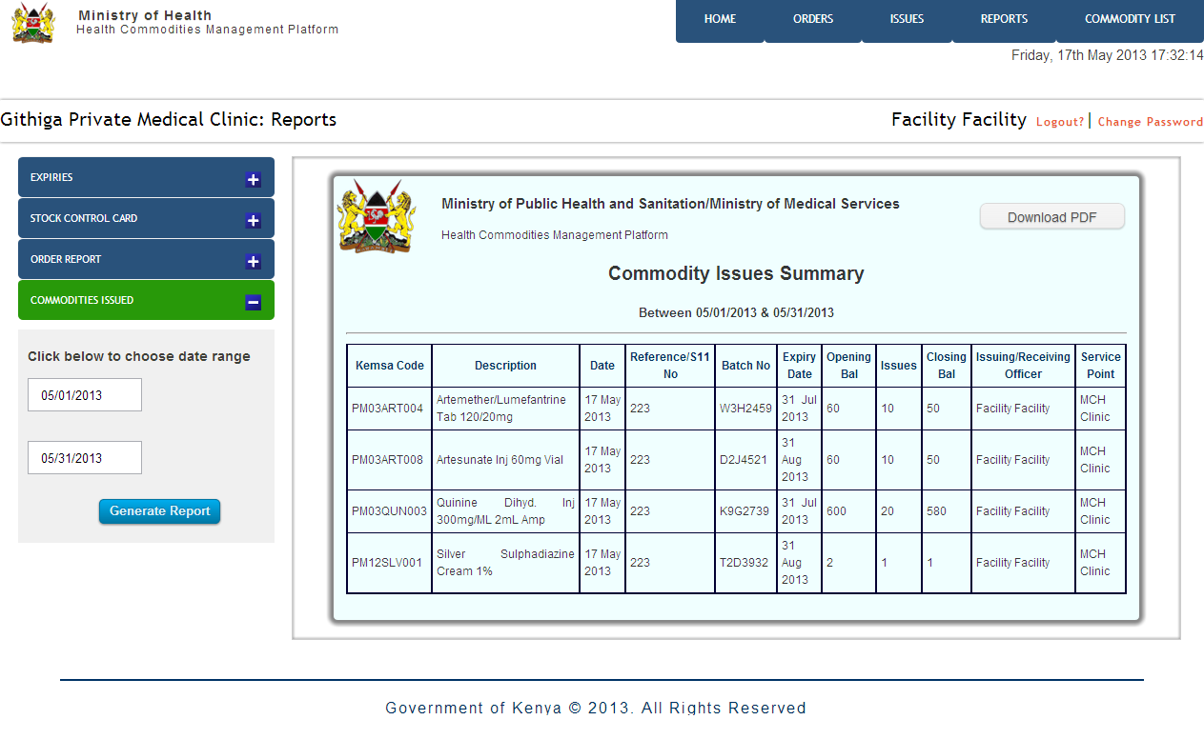
Facility Reports – Periodic Commodity Issues

Slide 27
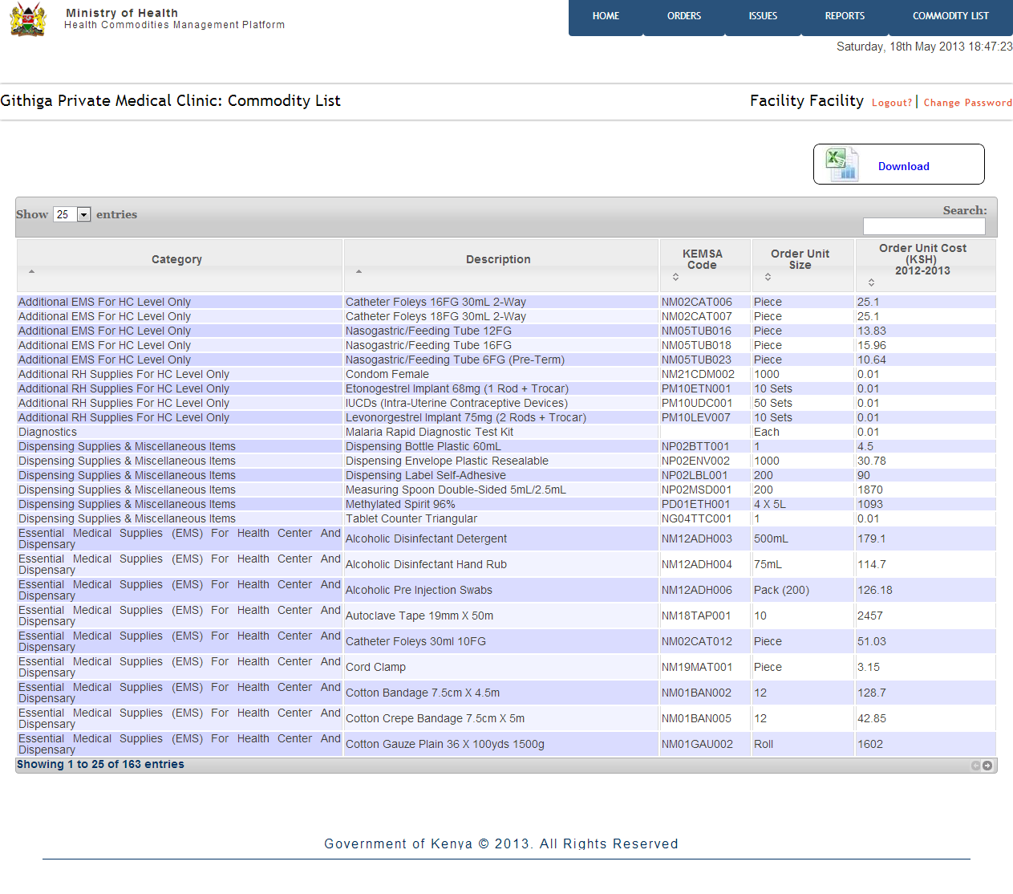
Facility Reports – Commodity List

Slide 28
LEVEL 2: DISTRICT PHARMACIST

Slide 29
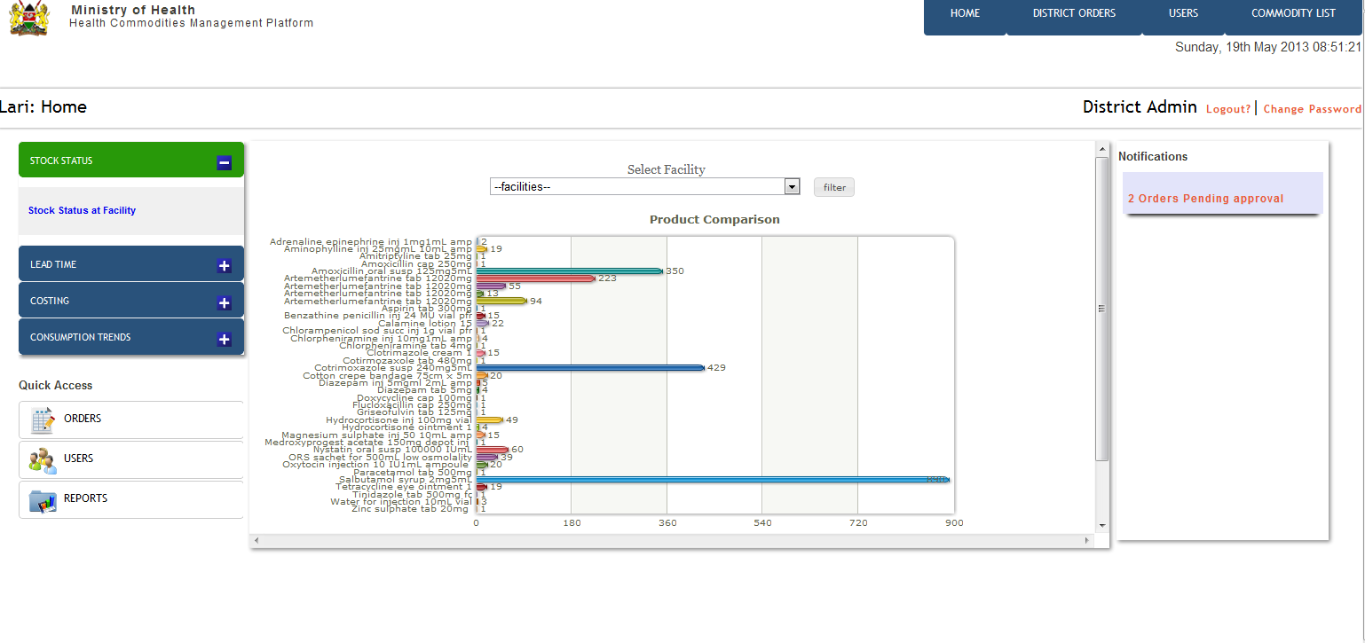
Dashboard – Commodities Stock Status

Slide 30
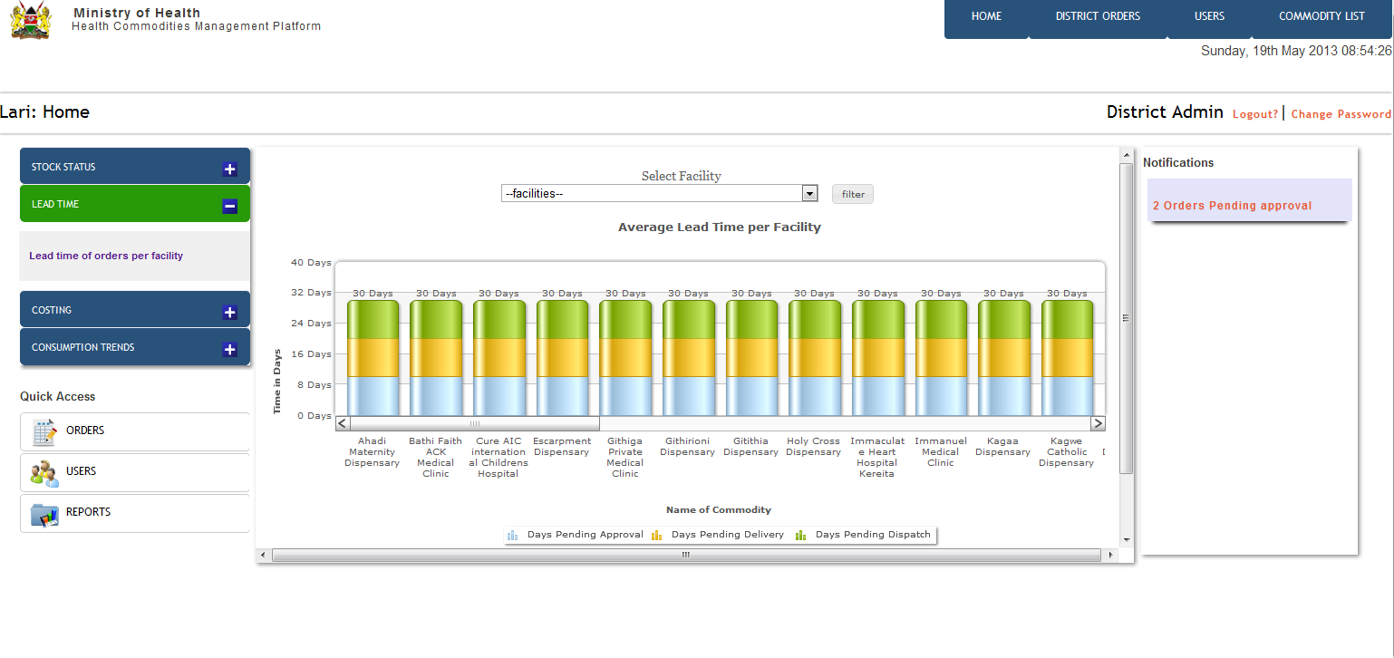
Dashboard – Orders Lead Time

Slide 31
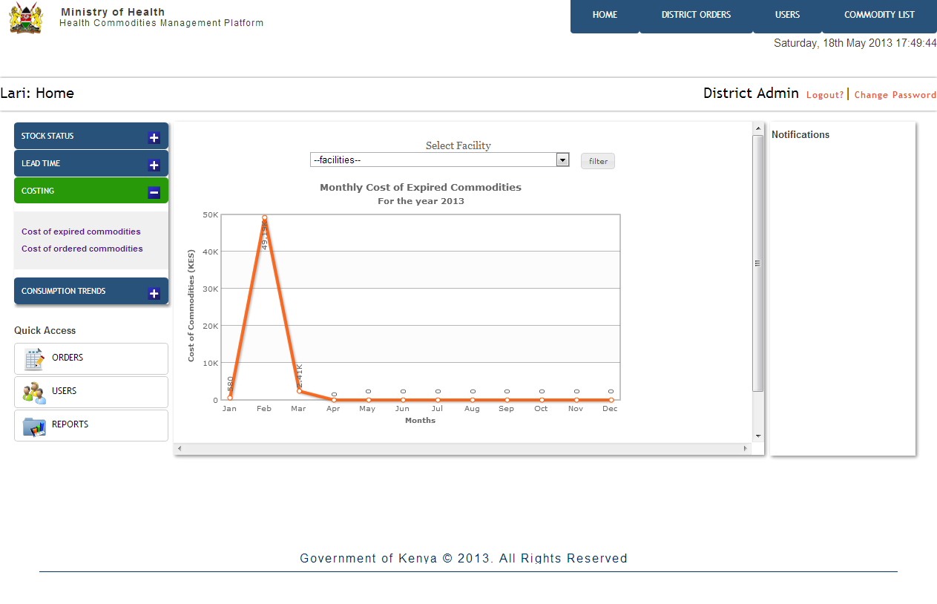
Dashboard – Cost of Expired Commodities

Slide 32
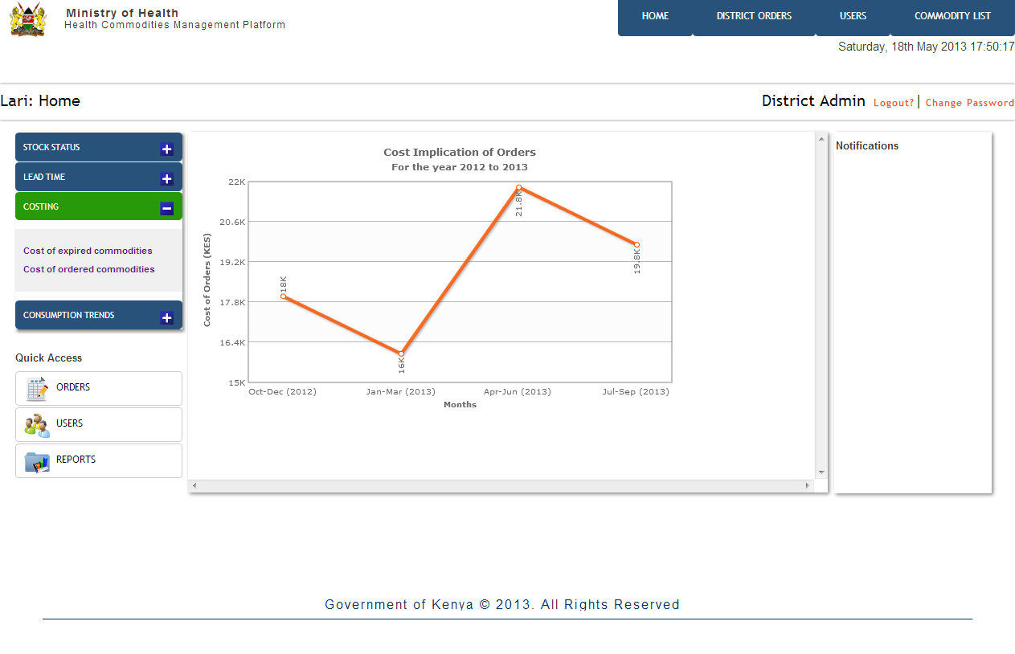
Dashboard – Cost of Orders Placed

Slide 33
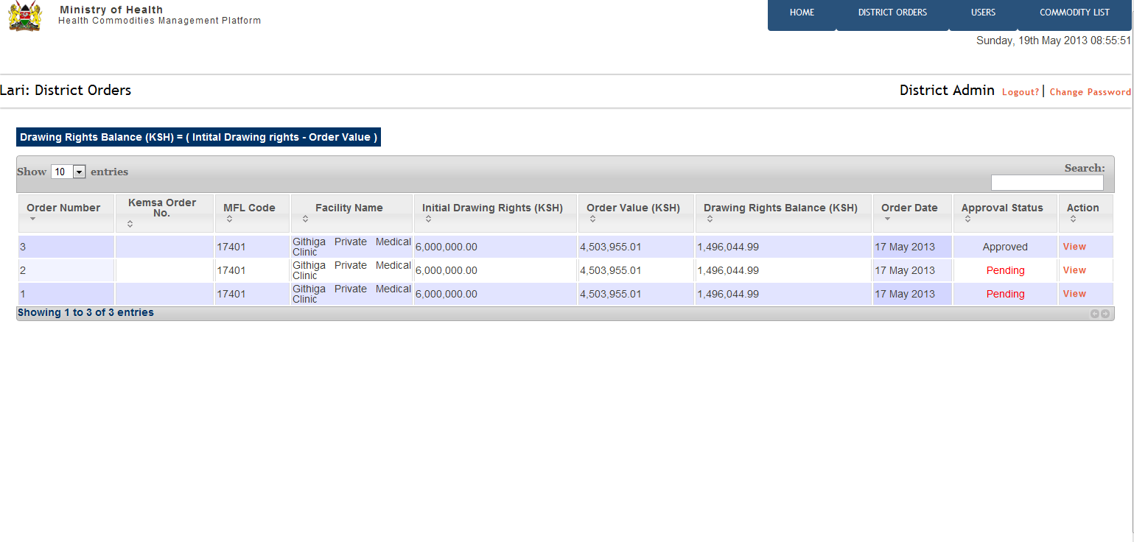
Orders Approval

Slide 34
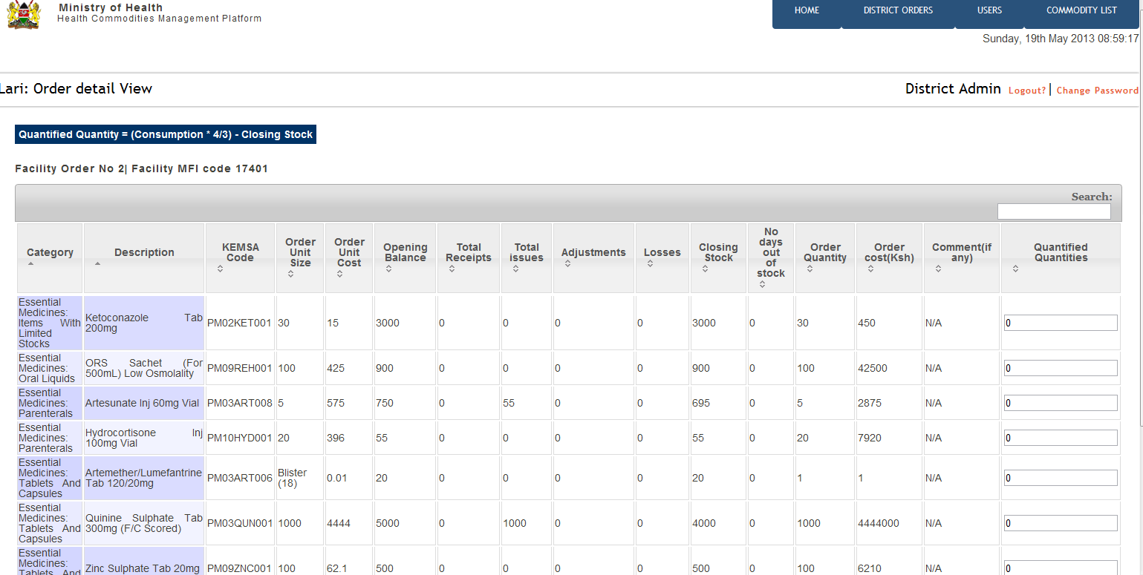
Orders Approval

Slide 35
Dashboard

Slide 36
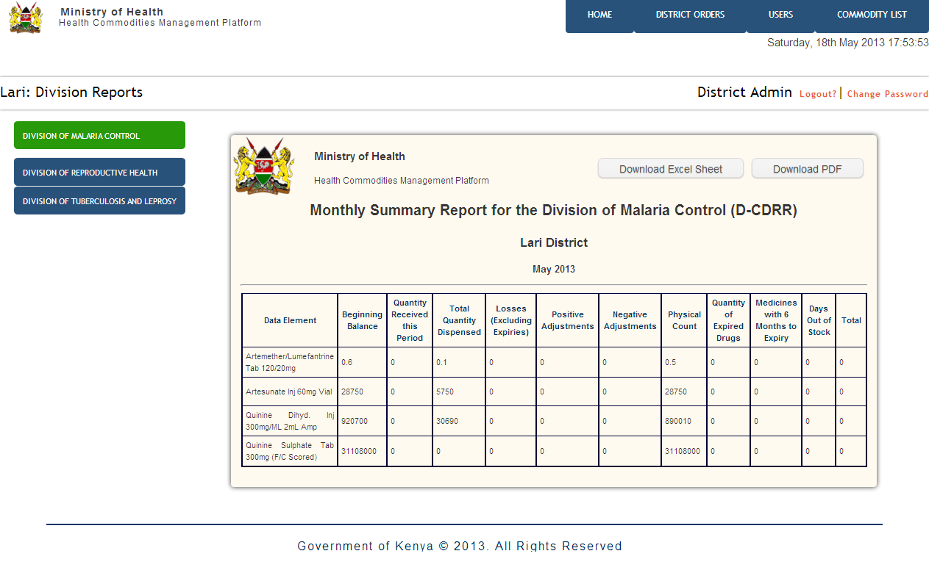
Division Reports – Division of Malaria Control

Slide 37
